Slide 1

Investment Advisor
Group Members:-
Shubham Shrivastava (PD14_221)
Indranil Ingale (PD14_070)
Hammad Hussain (PD14_017)
Ujwal Dhok (PD14_117)

Slide 2

Introduction
A investment advisor is one who provides guidance on how, where, and when to invest. The advice they provide could be for a wholesome ﬁnancial plan or individual investments made towards a larger ﬁnancial plan.
The analysis of the access of Customer Income and Expenses and guide him throughout the particular challenges while guiding him to invest his money for a better future.

Slide 3
Dataset
We had dataset of income and expense report of an individual containing date and time of activity, Payment Mode, amount involved and category whether we it was expense or income.
Along with this we had another dataset about various stocks listed on Bombay Stock Exchange with their various parameters related to the stock.
Aim of Project
To calculate Net expenditure and income. Money left for investment.
Suggest stocks based on risk profile.
Find Insights from data.

Slide 4
Challenges
We need to figure out how to connect sheet to Notebook as well as extract data from those sheet to analyse.
We had to clean data so we can calculate the values and fill it in sheet.
We overcame those challenges by finding resources and applying them on our projects.
For this purpose we used google api services and gspread module of python to extract data as well as update them into sheet.
Further cleaning of data was done with help of pandas library of python as well as calculation for values

Slide 5
Process
First we connected our APIs with our sheets with help of service email gained from service accounts and then connected Notebook with help of json key.
Then with help of gspread connected Excel files and worksheets
Created dataframes for different worksheets and calculations and data cleaning
Updated the sheet with help of gspread
Data visualization and Dashboard on Excel
For our KPI we selected Median price to earning ratio of stock till now,

Slide 6
Insights
Person in analysis just earned money between Nov-21 to Feb-22.
Most of transactions were done from online payment modes and not by cash.
Insurance Sector has highest median of Enterprise cap(Cr).
Services Sector has highest number of companies with positive 3 year return and Financial has highest negative 3 year return count.
Most amount of money was spent on Food whereas most amount of money was earned from other sources rather than salary or allowances,3 year returns,5 year returns and 10 year returns as all combined take care of risk profile,companies performance over years and not creating bias of any kind

Slide 7
Learnings
We learned to connect sheet and extract data from google sheets as well as update those sheets.
Along with that we learned to create dynamic values based on value in dashboard.
Also helped us gain some financial knowledge needed for analysis of stocks and markets.
Data cleaning and Data analysis specific to project

Slide 8
Insurance Sector has Highest median Enterprise Cap

Slide 9
Online Payment mode is mostly preferred. Expense and income in 2022 is more than that in 2021

Slide 10
Services is the good sector to invest money because its having highest Positive 3 year return companies as compare to negative 3 years return companies

Slide 11
Dividend is not depend on the market size of the company.

Slide 12
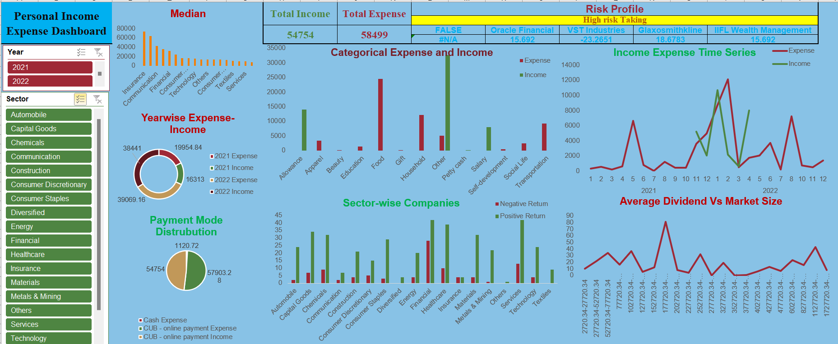
DASHBOARD

Slide 13


